Slide 1



Overview and application of Database
Lets Roll

Slide 2




Introduction to Database
Definition
Purpose
Benefits

Slide 3







Key concepts
Data
Tables
Relationships
Queries
Data manipulation

Slide 4
Advantages of Database
01
Reduce data redundancy
05
Allows integrity constraints
02
Remove data inconsistency
06
Concurrent access
03
Easy data access
07
Restricting unauthorized access
04
Guarantees Atomicity
08
Back up and recovery

Slide 5






Real world Applications
Banking and Finance
E-commerce
Healthcare
Ticket booking
Social media

Slide 6



Top most using
DataBase
Speed
Processing

Slide 7
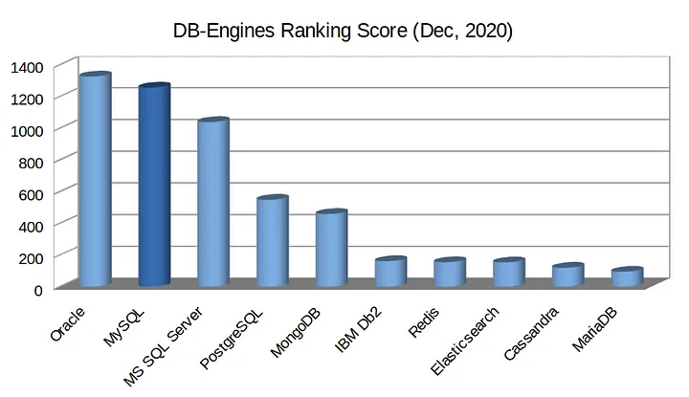
DB-Engines Ranking Score

Slide 8





Own Features
--- >> Distinctive attribute or aspect of something
Robustness and scalability
Flexibility and versatility
Extensibility and compliance
Flexible schema
Real-time synchronization

Slide 9
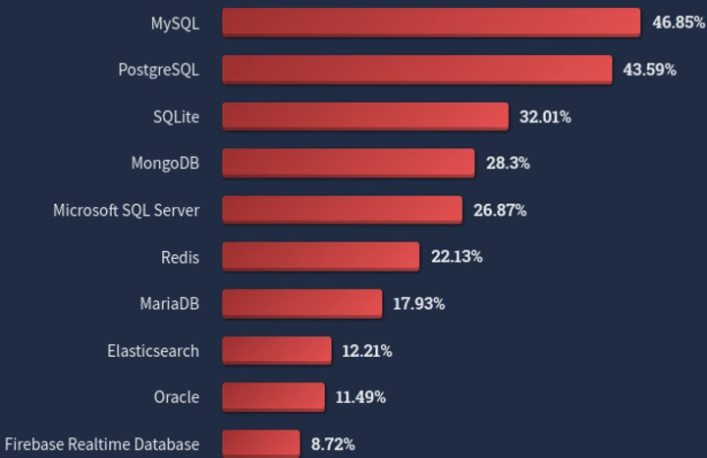
Top most Databases

Slide 10



How Can a Small Business Get Advantages from Big Data?
Process
Target
Analyze
By installing many big data provider apps or accessing the big data provider sets
Seeing the trends on the Internet and making conclusions from it
Analyze the user data from social media

Slide 11




Why MongoDB?
Flexible Schema
Real-Time Updates
Easy Integration
Community and Ecosystem
MongoDB's document-based data model provides flexibility in schema design.
MongoDB's support for real-time updates through its change streams and the MongoDB Atlas platform is valuable.
MongoDB has official drivers and libraries for various programming languages
the large and active developer community, offering resources, tutorials, and support

Slide 12
MongoDB DATA Model
No need of pre-defined schema, data is stored in flexible documents with dynamic schemas. This means that each document can have its own unique structure, and fields can be added or removed as needed
Another key concept in MongoDB is collections, which are groups of related documents. unlike tables, collections do not enforce a schema, and documents within a collection can have different structures.

Slide 13





Security Of Database
Auditing, Monitoring,
&
Backup
Network Security
&
SQL Injection Prevention
Employee Training &
Physical Security
Access Control
&
Encryption

Slide 14
Access Control and Encryption
Access control:
User authentication
Authorization
Role-based access control (RBAC)
Encryption:
Data encryption at rest
Data encryption in transit

Slide 15
Auditing, Monitoring, and Backup
Auditing and monitoring:
Identifying suspicious activities
Regular review of audit logs
Backup and recovery:
Data integrity and resilience
Business continuity

Slide 16
Network Security and SQL Injection Prevention
Network security:
Secure network configurations
Firewalls, IDS, and VPNs
SQL injection prevention:
Parameterized queries and prepared statements

Slide 17
Employee Training and Physical Security
Employee training:
Password policies
Social engineering awareness
Physical security:
Preventing unauthorized access

Slide 18
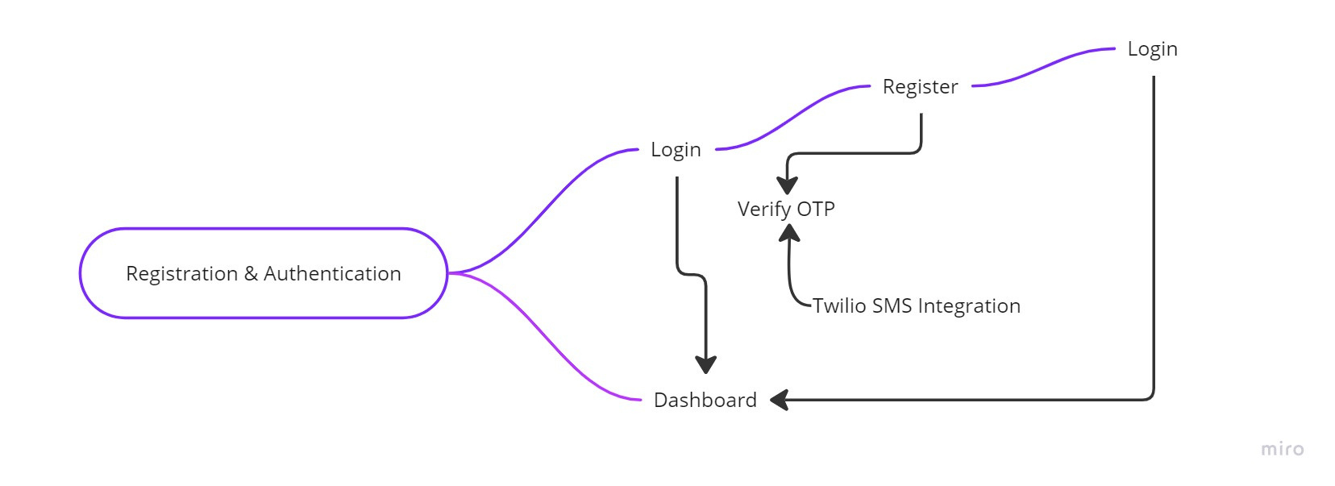
Flow of MongoDB Project

Slide 19
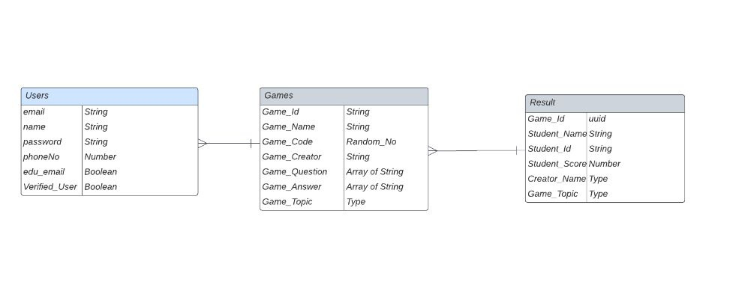
Schema Designing of the
MongoDB Project

Slide 20

Thank You
www.reallygreatsite.com

